Slide 1
Software Installation
This is not a lecture but a guide for students to self-install the software used in the labs

Slide 2
Uninstall Existing Java/JDK
Java Development Kit (JDK) is used in this course.
Most of the problems faced by students are caused by unknowingly installed multiple versions of JDK or incorrect installation.
Search "Java" or "JDK" in your app list.
Uninstall all of them.
How do I uninstall Java on my Windows computer?

Slide 3
Software for Java Development
Java compiler: Azul Zulu JDK 23
Azul Zulu JDK 23 for Windows
Read the next slide for setting JAVA_HOME
Azul Zulu JDK 23 for Mac
IDE: Visual Studio Code
Extension Pack for Java

Slide 4
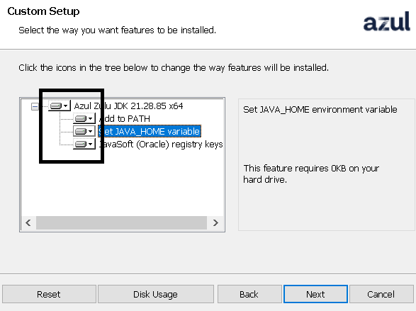
JAVA_HOME
Windows
At the step below, change JAVA_HOME option to Will be installed on local drive.

Slide 5
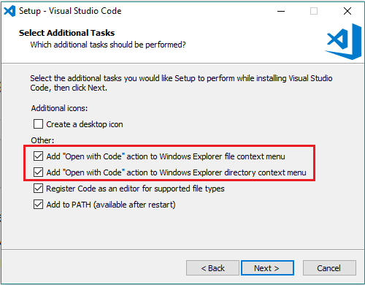
Visual Studio Code
Download Visual Studio Code
Windows: Choose System Installer x64.
Tick Open with Code options as follows:

Slide 6
Extension Pack for Java
Install Extension Pack for Java in VS Code.

Slide 7
Test Your Installation
Launch VS Code.
Click File menu > Open Folder.
Select the Code folder.
Click Welcome.java.
Click Run menu > Run Without Debugging.
If there is no error, a Hello world message will be output.

Slide 8
Open Folder in VS Code
In VS Code, a folder is a project. Hence, always use the Open Folder feature to open the folder containing your .java file.
If you open a .java file directly without Open Folder, it may not work.

